Slide 1
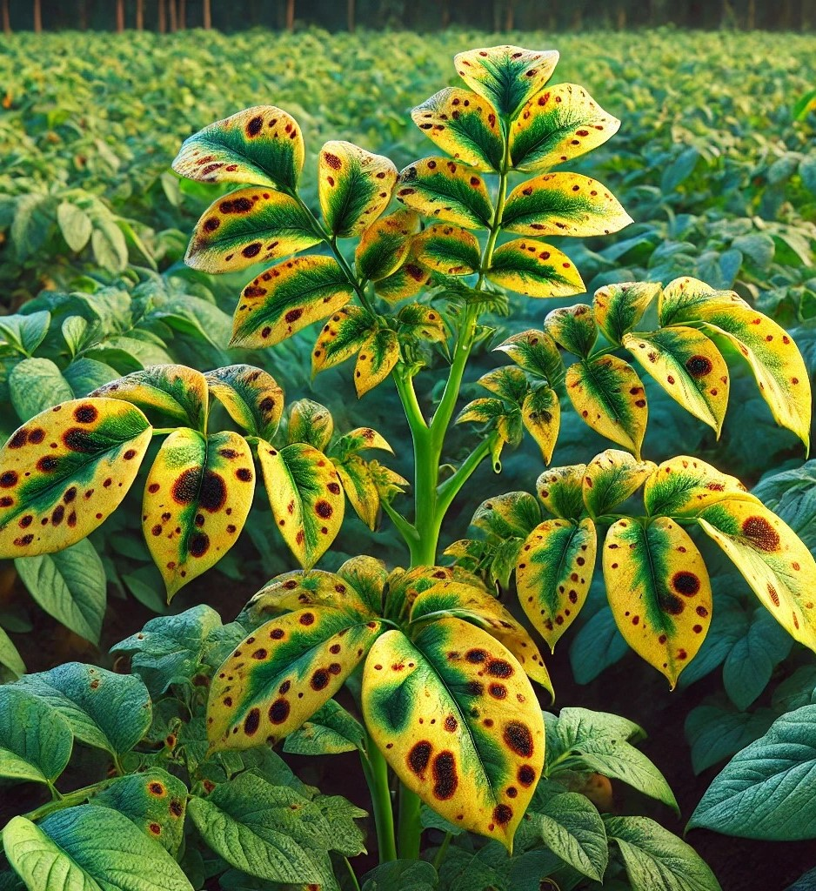
Potato Disease Detection App
A Mobile Application for Early Blight and Late Blight Identification using CNN

Slide 2
Our Project Team
Roll No. | Members
1. | Aachal Badjate
10. | Niharika Nashine
28. | Akshat Sharma
31. | Atharva Shakargayen
45. | Om Zawar

Slide 3
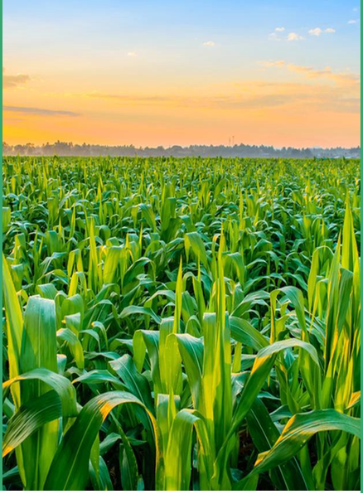

INDEX
Introduction
Project Objectives
Proposed Plan of Work
Advantages
Project scope
Conclusion

Slide 4
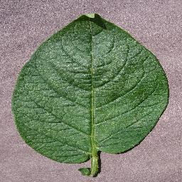
Introduction
Potato farming is a critical part of the agricultural industry in India, contributing to food security and economic stability in many regions. However, potato crops are highly vulnerable to diseases, particularly early blight and late blight, which are caused by fungal pathogens. Traditional methods for disease detection are time-consuming and require expert knowledge, which many farmers may not have access to.
This project aims to leverage modern technology to address this issue by developing a mobile application that uses image classification through Convolutional Neural Networks (CNN). The application will enable farmers to take pictures of potato plants and receive immediate feedback on whether the plant is healthy or affected by early blight or late blight. This tool will empower farmers with actionable insights, allowing them to take preventative measures and minimize crop losses.

Slide 5
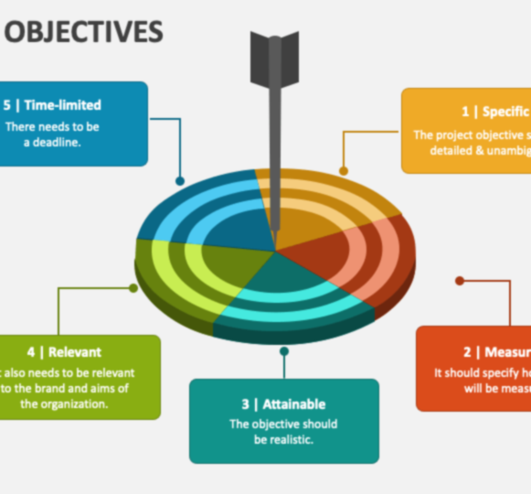
Project objectives
Disease Detection with CNN: Develop a robust deep learning model using CNN to accurately classify potato plant images into three categories: healthy, early blight, or late blight.
Mobile Application Development: Build an intuitive mobile application using React Native that allows farmers to take pictures of potato plants and receive real-time disease diagnosis.

Slide 6
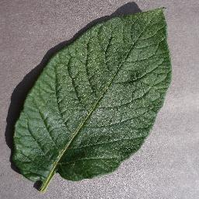
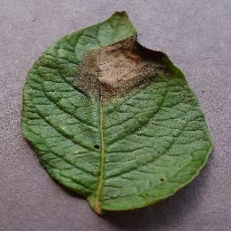
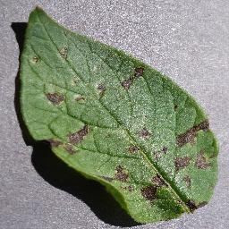
Backend Development and Scalability:- Implement a scalable backend system using FastAPI to manage requests, serve the trained model, and return results efficiently,.
Cloud Deployment for Reliability:- Deploy the entire application on a reliable cloud platform like Google Cloud Platform (GCP), ensuring high availability, scalability, and security.

Slide 7
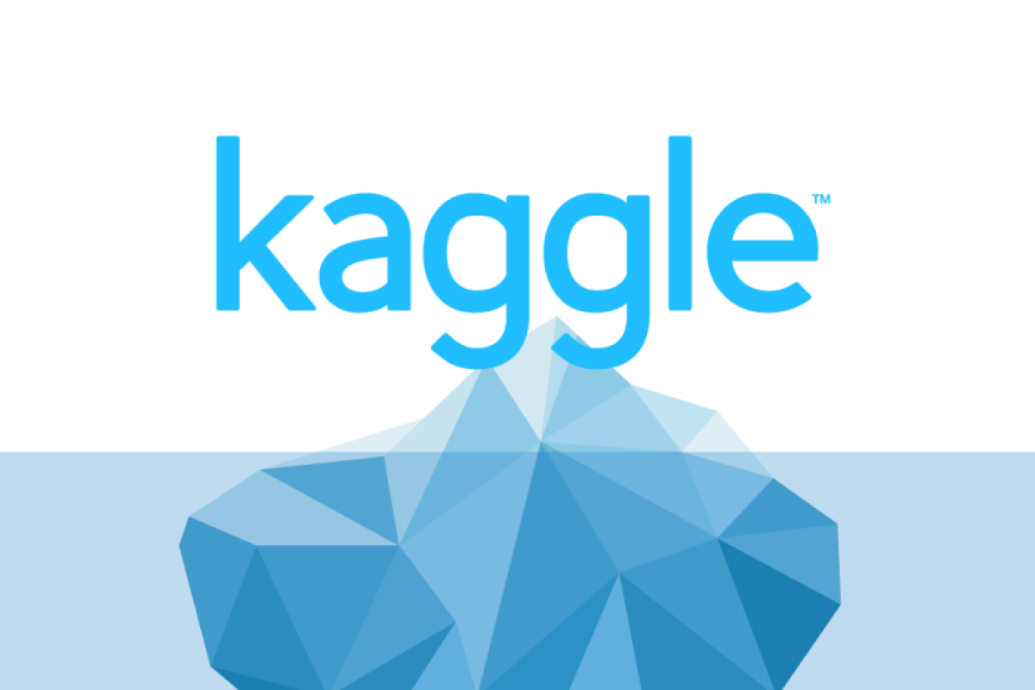
Proposed Plan of Work
DATA COLLECTION AND PREPROCESSING:-
Dataset Source:- Kaggle
Dataset Name:- Plant Village
Link:-https://www.kaggle.com/datasets/arjuntejaswi/plant-village/discussion?sort=hotness
Dataset size:- Official- 344Mb
Downloadable- 329Mb

Slide 8
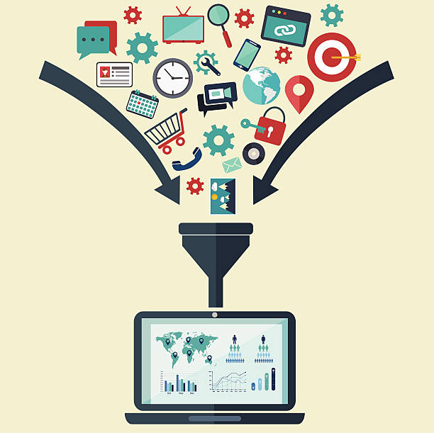
DATA COLLECTION AND PREPROCESSING:-
Data Gathering:- Acquire a comprehensive dataset consisting of images of healthy potato plants as well as those affected by early blight and late blight. This can be sourced from publicly available plant disease datasets, agricultural research centers, or through collaboration with farmers.
Data Augmentation:- Since plant disease datasets can often be limited, data augmentation techniques such as rotation, flipping, zooming, and contrast adjustments will be used to artificially increase the size of the dataset.

Slide 9

Data Labeling and Splitting:- Label the images into the three categories (healthy, early blight, late blight) and split the dataset into training, validation, and test sets to ensure effective model training and evaluation.
MODEL DEVELOPMENT:-
CNN Architecture: Design and develop a CNN architecture using TensorFlow that can accurately classify the images. This will include several convolutional layers for feature extraction, followed by pooling layers, and dense layers for classification. Techniques such as dropout and batch normalization will be used to prevent overfitting and improve training stability.

Slide 10
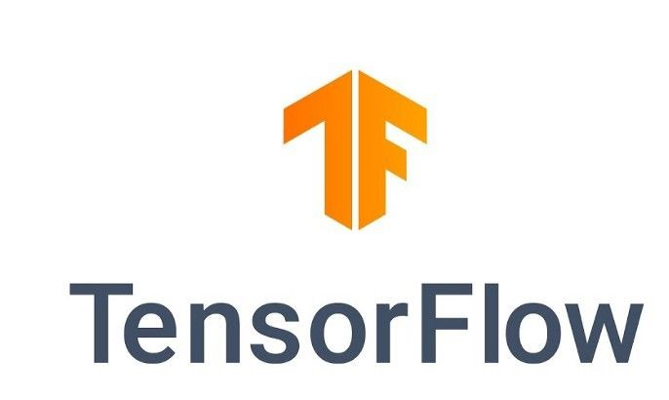
Training the Model:- Train the CNN model using the preprocessed dataset, ensuring that the model can learn to distinguish between healthy plants and those affected by early or late blight. Use techniques such as transfer learning to improve performance if needed.
Hyperparameter Tuning:- Experiment with different hyperparameters such as learning rates, batch sizes, and optimizer types to optimize the model's performance. Use tools like TensorBoard to monitor training metrics and fine-tune the model.

Slide 11
Evaluation:- Evaluate the model on the test set using performance metrics such as accuracy, precision, recall, and F1-score to ensure that it meets the required standards for deployment.

Slide 12
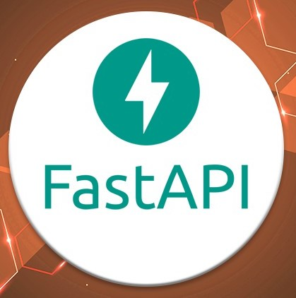
BACKEND DEVELOPMENT:-
FastAPI Server Setup:- Build a FastAPI server that will handle image upload requests from the mobile app. The server will process the images and pass them to the trained model for inference.
TensorFlow Serving Integration:- Deploy the trained CNN model using TensorFlow Serving, which is designed for production environments. TensorFlow Serving will handle model inference requests efficiently and allow easy versioning and updates of the model without affecting the service.

Slide 13
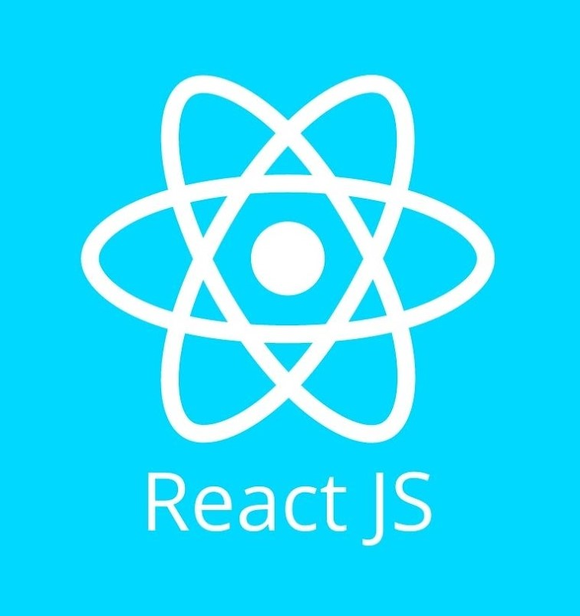
API Development:- Implement APIs for image upload, model inference, and result retrieval. These APIs will facilitate communication between the mobile app and the backend server.
Database Integration:- If required, integrate a database (e.g., PostgreSQL or MongoDB) to store historical data, such as past predictions, user information, or diagnostic results for further analysis.

Slide 14
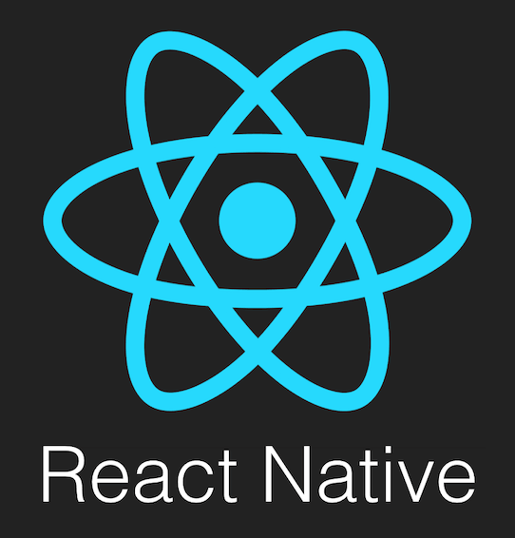
FRONTEND DEVELOPMENT:-
React Native Mobile Application:- Develop a mobile application using React Native that allows farmers to capture images of potato plants using their smartphones. The app will feature an intuitive user interface with simple navigation to upload images and view results. React JS Web Interface:- Create a web interface using React JS for additional functionalities, such as monitoring model performance, visualizing data trends, or providing more detailed information to agricultural experts.
User Experience (UX) and Testing:- Focus on building a user-friendly experience that requires minimal effort from farmers.

Slide 15
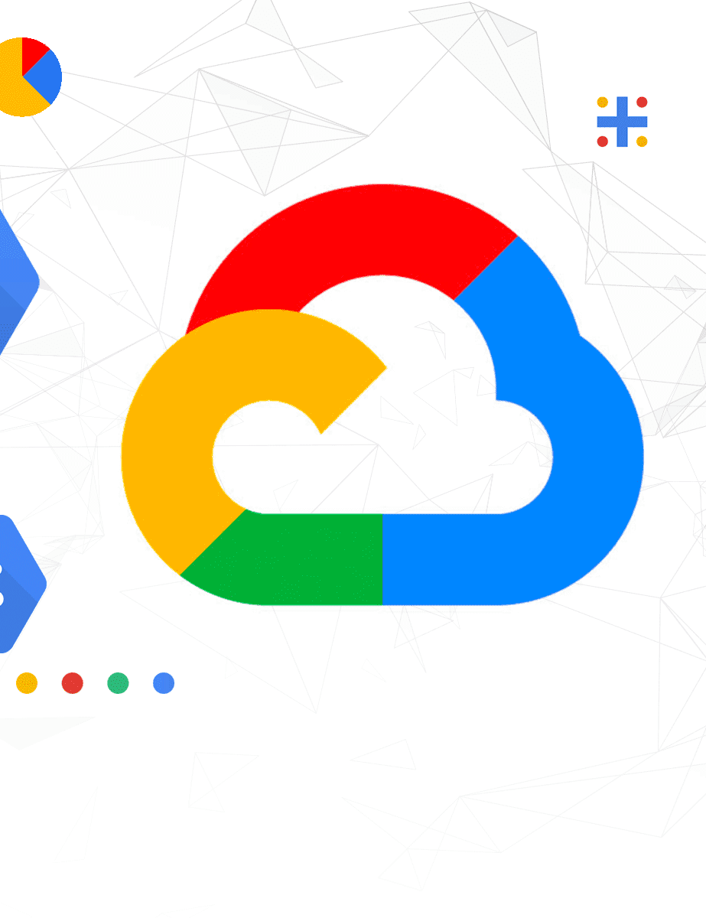
DEPLOYMENT:-
Cloud Deployment on GCP:- Deploy the backend server, trained model, and web interface on Google Cloud Platform (GCP). Use services like GCP Compute Engine for backend hosting, GCP Cloud Storage for storing model files and image data, and GCP API Gateway for secure and scalable API management.
Alternative Deployment Options:- If avoiding GCP, consider using AWS or Azure for cloud deployment. Alternatively, Heroku can be used for simpler deployments, or Docker containers can be deployed on on-premises servers or private cloud infrastructure.
Integration of Mobile App:- Integrate the React Native mobile app with the deployed backend for seamless communication and real-time disease detection.

Slide 16
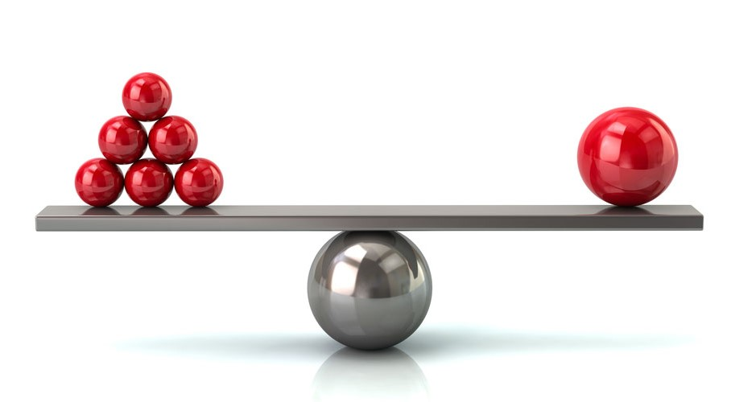
Advantages
Real-Time Disease Detection:- The mobile application provides farmers with instant disease identification, allowing them to take immediate action.
Increased Accuracy with Deep Learning:- By utilizing CNNs trained on thousands of images, the app ensures high accuracy in detecting early blight and late blight.
Accessible to Farmers in Remote Areas:- The app brings advanced technology to farmers' fingertips, especially those in remote areas. All they need is a smartphone with the app installed, making disease detection more accessible.

Slide 17
Cost-Effective Solution:- The application is a cost-effective alternative to expensive manual inspections or consultations with experts. By using machine learning, it reduces operational costs while delivering high-quality disease detection.
Data-Driven Agriculture:- The app promotes smarter, data-driven farming practices. By capturing and storing disease data over time, it can help farmers track trends, analyze disease patterns, and make informed decisions for future crops.
Scalability and Flexibility:- The backend architecture, built using FastAPI and TensorFlow Serving, is designed for scalability. Whether there are a few users or thousands, the system can handle the demand by deploying on cloud platforms like GCP or alternatives like AWS.

Slide 18
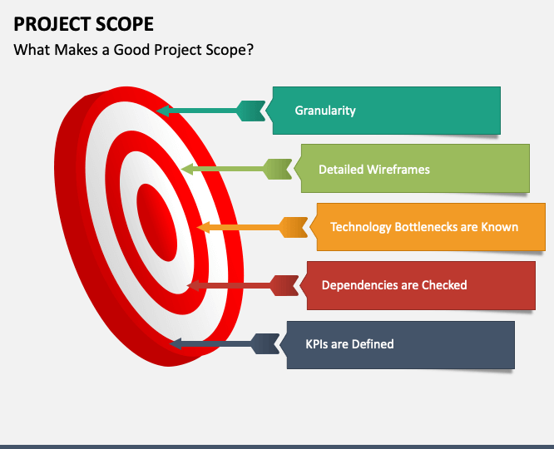
Project Scope
Expansion to Other Crops:- The framework can be adapted to detect diseases in various crops such as tomatoes, wheat, and corn, making the app useful across multiple agricultural sectors.
Integration of Predictive Analytics- The app could incorporate weather and environmental data to predict disease outbreaks before they occur, allowing farmers to take preventative measures.
Multi-Disease Detection:-The model can be expanded to detect multiple diseases simultaneously, providing comprehensive crop health monitoring.

Slide 19
IoT Integration: Future versions could integrate with IoT devices like smart cameras and drones for automated disease detection across larger fields.
Global Accessibility: By adding multilingual support and regional customization, the app could be deployed worldwide, helping farmers in diverse climates and conditions.
Data-Driven Insights: The app could offer detailed reports and analytics to help farmers make data-driven decisions about crop management and disease prevention strategies.
Partnerships with Agricultural Organizations: Collaborations with agricultural extension services or NGOs could promote widespread adoption and provide additional support to farmers.

Slide 20
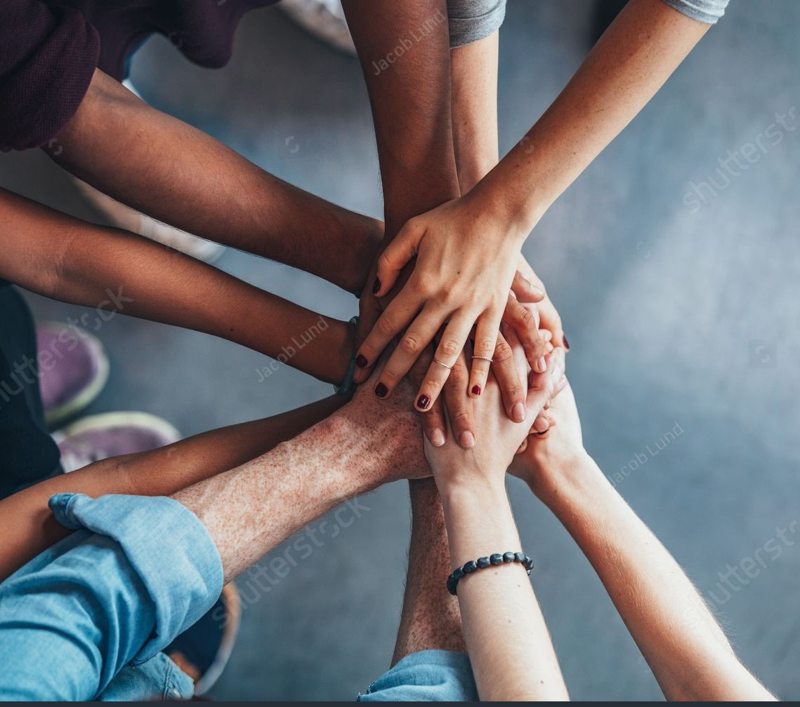
Conclusion
The potato plant disease detection mobile application is an innovative and impactful tool designed to transform the way farmers identify and manage crop diseases. By integrating cutting-edge technologies such as CNNs, TensorFlow Serving, and cloud computing, this project addresses the critical need for accurate and timely disease detection in agriculture. The application not only empowers farmers with actionable insights but also offers a scalable, cost-effective, and user-friendly solution that can significantly improve crop health and productivity.

Slide 21

References
Official TensorFlow Keras Documentation: https://www.tensorflow.org/guide/keras
FastAPI Documentation: https://fastapi.tiangolo.com/
Integrating FastAPI with TensorFlow Serving: https://medium.com/google-developer-experts/load-testing-tensorflow-serving-and-fastapi-on-gke-411bc14d96b2
GCP Documentation: https://cloud.google.com/
Deploying a TensorFlow Model on GCP:- https://blog.tensorflow.org/2020/04/how-to-deploy-tensorflow-2-models-on-cloud-ai-platform.com

Slide 22

Thank you everyone

